Slide 1




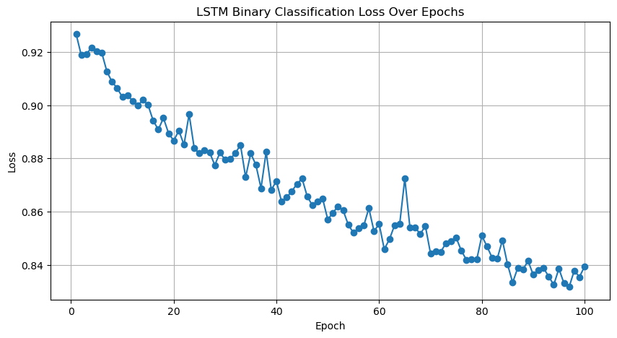
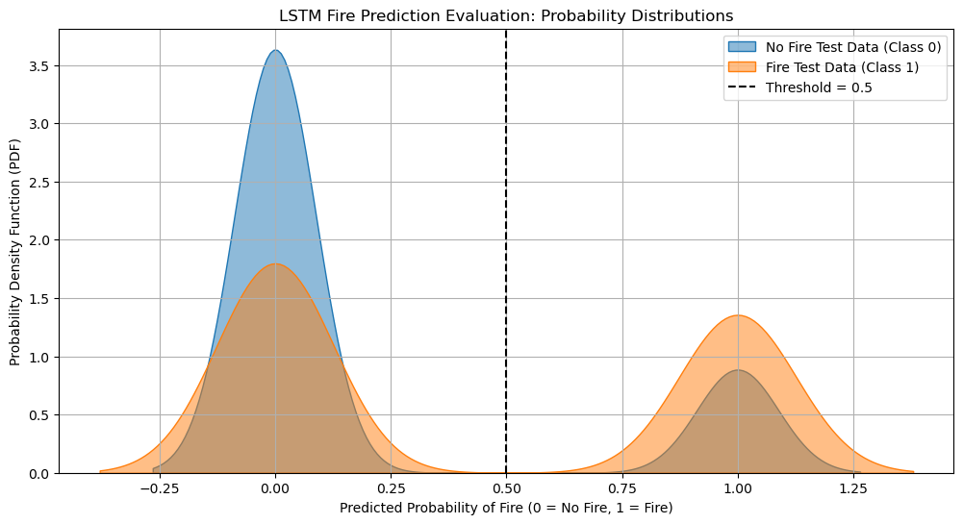
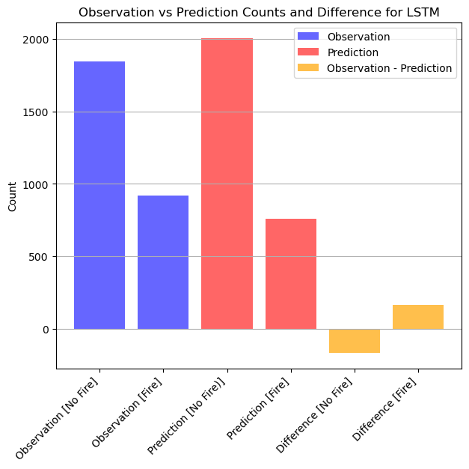
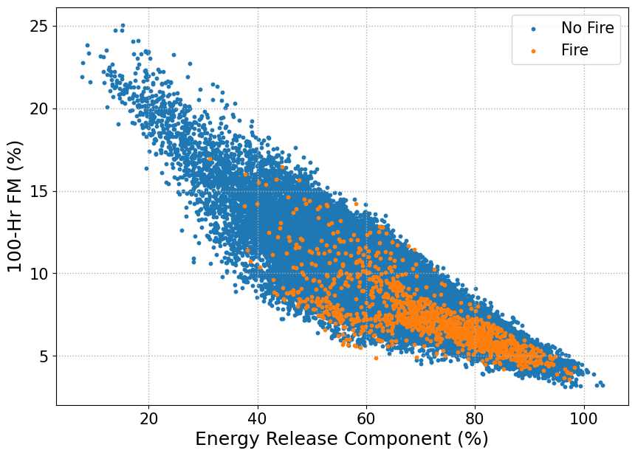
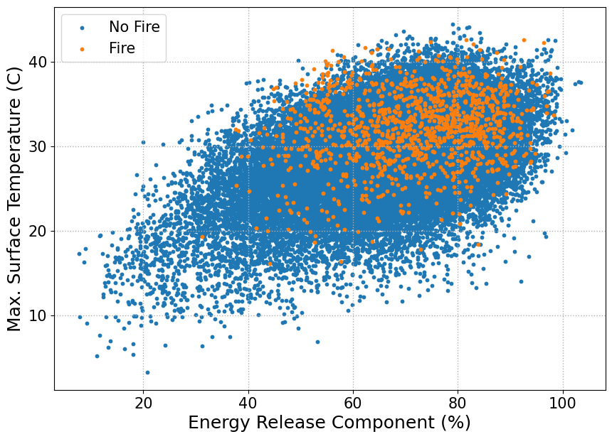
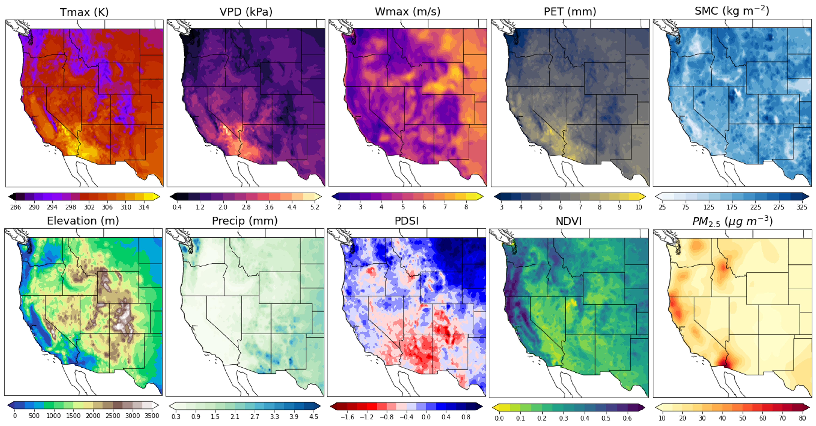
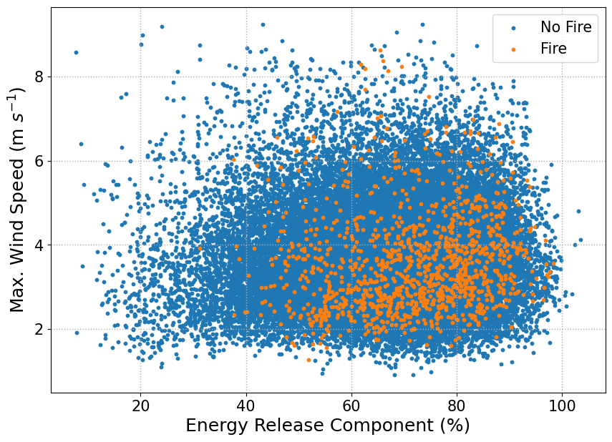
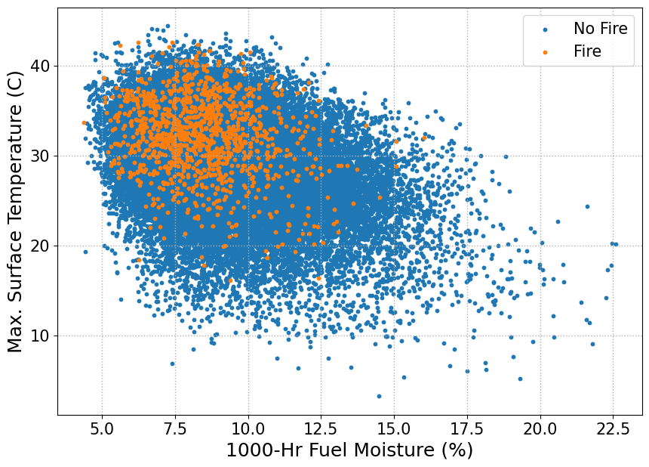
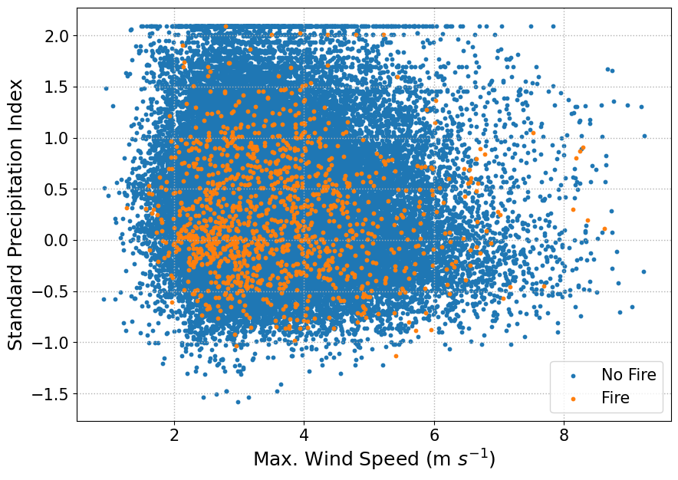
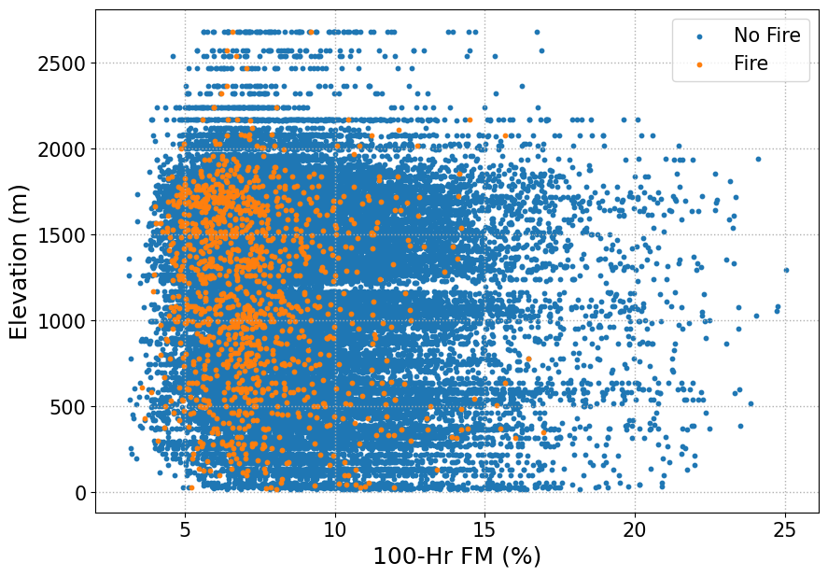
Leveraging NASA Historical Big Data and Deep Learning Techniques to Assess Wildland Fires
Rahele B. Vaezi^{1,2}, Michael R. Martin^{1,2}, Farnaz Hosseinpour^{1,2}
                1. Desert Research Institute 2. University of Nevada, Reno
                Correspondence: Rahele.BarjesteVaezi@dri.edu
Abstract
Deep Learning Methods for Wildfire Classification
Wildland fires present an escalating challenge threat in California, with their frequency and intensity growing. These fires pose significant risks to both the environment and communities, making it crucial to better understand the complex relationships between wildfires and environmental conditions to enhance strategies for mitigation and resilience. This research aims to identify long-term patterns and the probability of wildfire occurrence in relation to various environmental conditions. Various statistical analysis, pattern recognition techniques and Deep Learning techniques have been employed using ensemble of NASA’s Moderate Resolution Imaging Spectroradiometer (MODIS) observations, and the Gridded Surface Meteorological Big Data over 24 years of fire seasons. Machine Learning (ML), including Deep Learning techniques are powerful tools for analyzing large, multi-variable datasets in wildfire studies, uncovering intricate patterns and relationships that may be challenging or impossible to detect with traditional methods. This study leverages ML techniques to further explore the complex relationships between wildland fires and key environmental variables with greater depth and accuracy.
This figure shows the model improving as the loss function decreases with more epochs (training iterations). A steady decline indicates learning, while flattening suggests convergence.
A loss function measures how far the model's predictions are from the actual values.
The x-axis represents the predicted probability of fire (ranging from 0 to 1).
The y-axis (Probability Density Function output) shows how frequently certain probability values appear, smoothed out using a "Kernel Density Estimate" (KDE) plot.
The word "Test" means actual unseen data that the model predicts.
The figure above shows The model performance versus observation, highlighting its accuracy in predicting wildfire occurrences. Close alignment indicates strong predictive capability, while discrepancies suggest areas for improvement.
Fire-Weather Relationships
Fire Season Climatology, JAS 1996-2020
Acknowledgments
This material is based upon work supported by Nevada NASA EPSCoR under Grant No. 80NSSC22M0037.
  References
Vaezi, R.B., Hosseinpour, F. E. (2025) Big Data in Environmental Science: Insights into Wildfire Smoke Emission. Data Science Conference, NV, Reno, February 18, 2024, http://dx.doi.org/10.13140/RG.2.2.36367.29604
Vaezi, R.B., Martin, M. R., Hosseinpour, F. E. (2024). Impacts of Wildfire Smoke Aerosols on Radiation, Clouds, Precipitation, Climate, and Air Quality, Atmospheric Environment, Elsevier, https://dx.doi.org/10.2139/ssrn.5051411, Preprint.
Vaezi, B. R., Martin, M. R., Hosseinpour, F. E. (2024). Machine Learning for Exploring Wildfire Smoke Emissions: A Data-Driven Approach, 2024 Nevada NASA Statewide Meeting, April 2024, http://dx.doi.org/10.13140/RG.2.2.32342.05449/1
Vaezi, B. R., Mehdizadeh, G., Martin, M. R., Hosseinpour, F. E. (2024). Machine Learning Approach for Enhanced Understanding of California’s Wildfire Smoke. American Meteorological Society (AMS) 104th Annual Meeting, Baltimore, MD, January 28-February 1, 2024, http://dx.doi.org/10.13140/RG.2.2.23069.49120/1
Martin, M., Yang, L., Hosseinpour, F. (2025) Leveraging Machine Learning and NASA Satellite Data to Improve Wildfire Smoke Prediction and Environmental Insights. Data Science Conference, Reno, NV, February 18, 2024, http://dx.doi.org/10.13140/RG.2.2.32402.36808
Martin, M., Yang, L., Hosseinpour, F. (2025) Harnessing Machine Learning and NASA Satellite Big Data for Enhanced Wildfire Smoke Prediction and Air Quality Forecasting, Data Science Conference, Reno, NV, February 18, 2024, http://dx.doi.org/10.13140/RG.2.2.28208.06406
Martin, M. R., Mehdizadeh, G., Vaezi, B. R., Erfani, E., Hosseinpour, F. E. (2024). Predictive Modeling in Environmental Science with Machine Learning Algorithms. American Meteorological Society (AMS)104th Annual Meeting, Baltimore, MD, January 29, 2024, http://doi.org/10.13140/RG.2.2.18875.18729/2,
Hosseinpour, F., Kumar, N., Tran, T., & Knipping, E. (2023). Using machine learning to improve the estimate of US background ozone. Atmospheric Environment, 316, 120145. https://doi.org/10.1016/j.atmosenv.2023.120145
Complex, non-linear relationships exist between environmental variables that influence fire occurrence.
Deep learning can be leveraged to model these intricate relationships, improving fire prediction and risk assessment.
The Southwestern U.S. deserts experience hot and dry conditions.
The mountains and parts of the Pacific Northwest remain cool and humid.
PM2.5 concentrations are elevated in urban areas and regions affected by wildfires.

