Slide 1


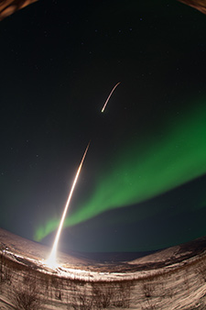
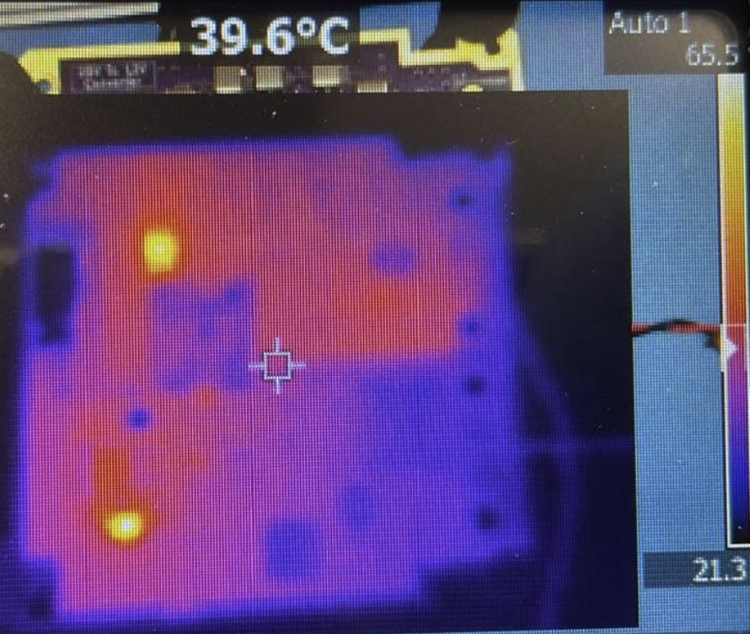
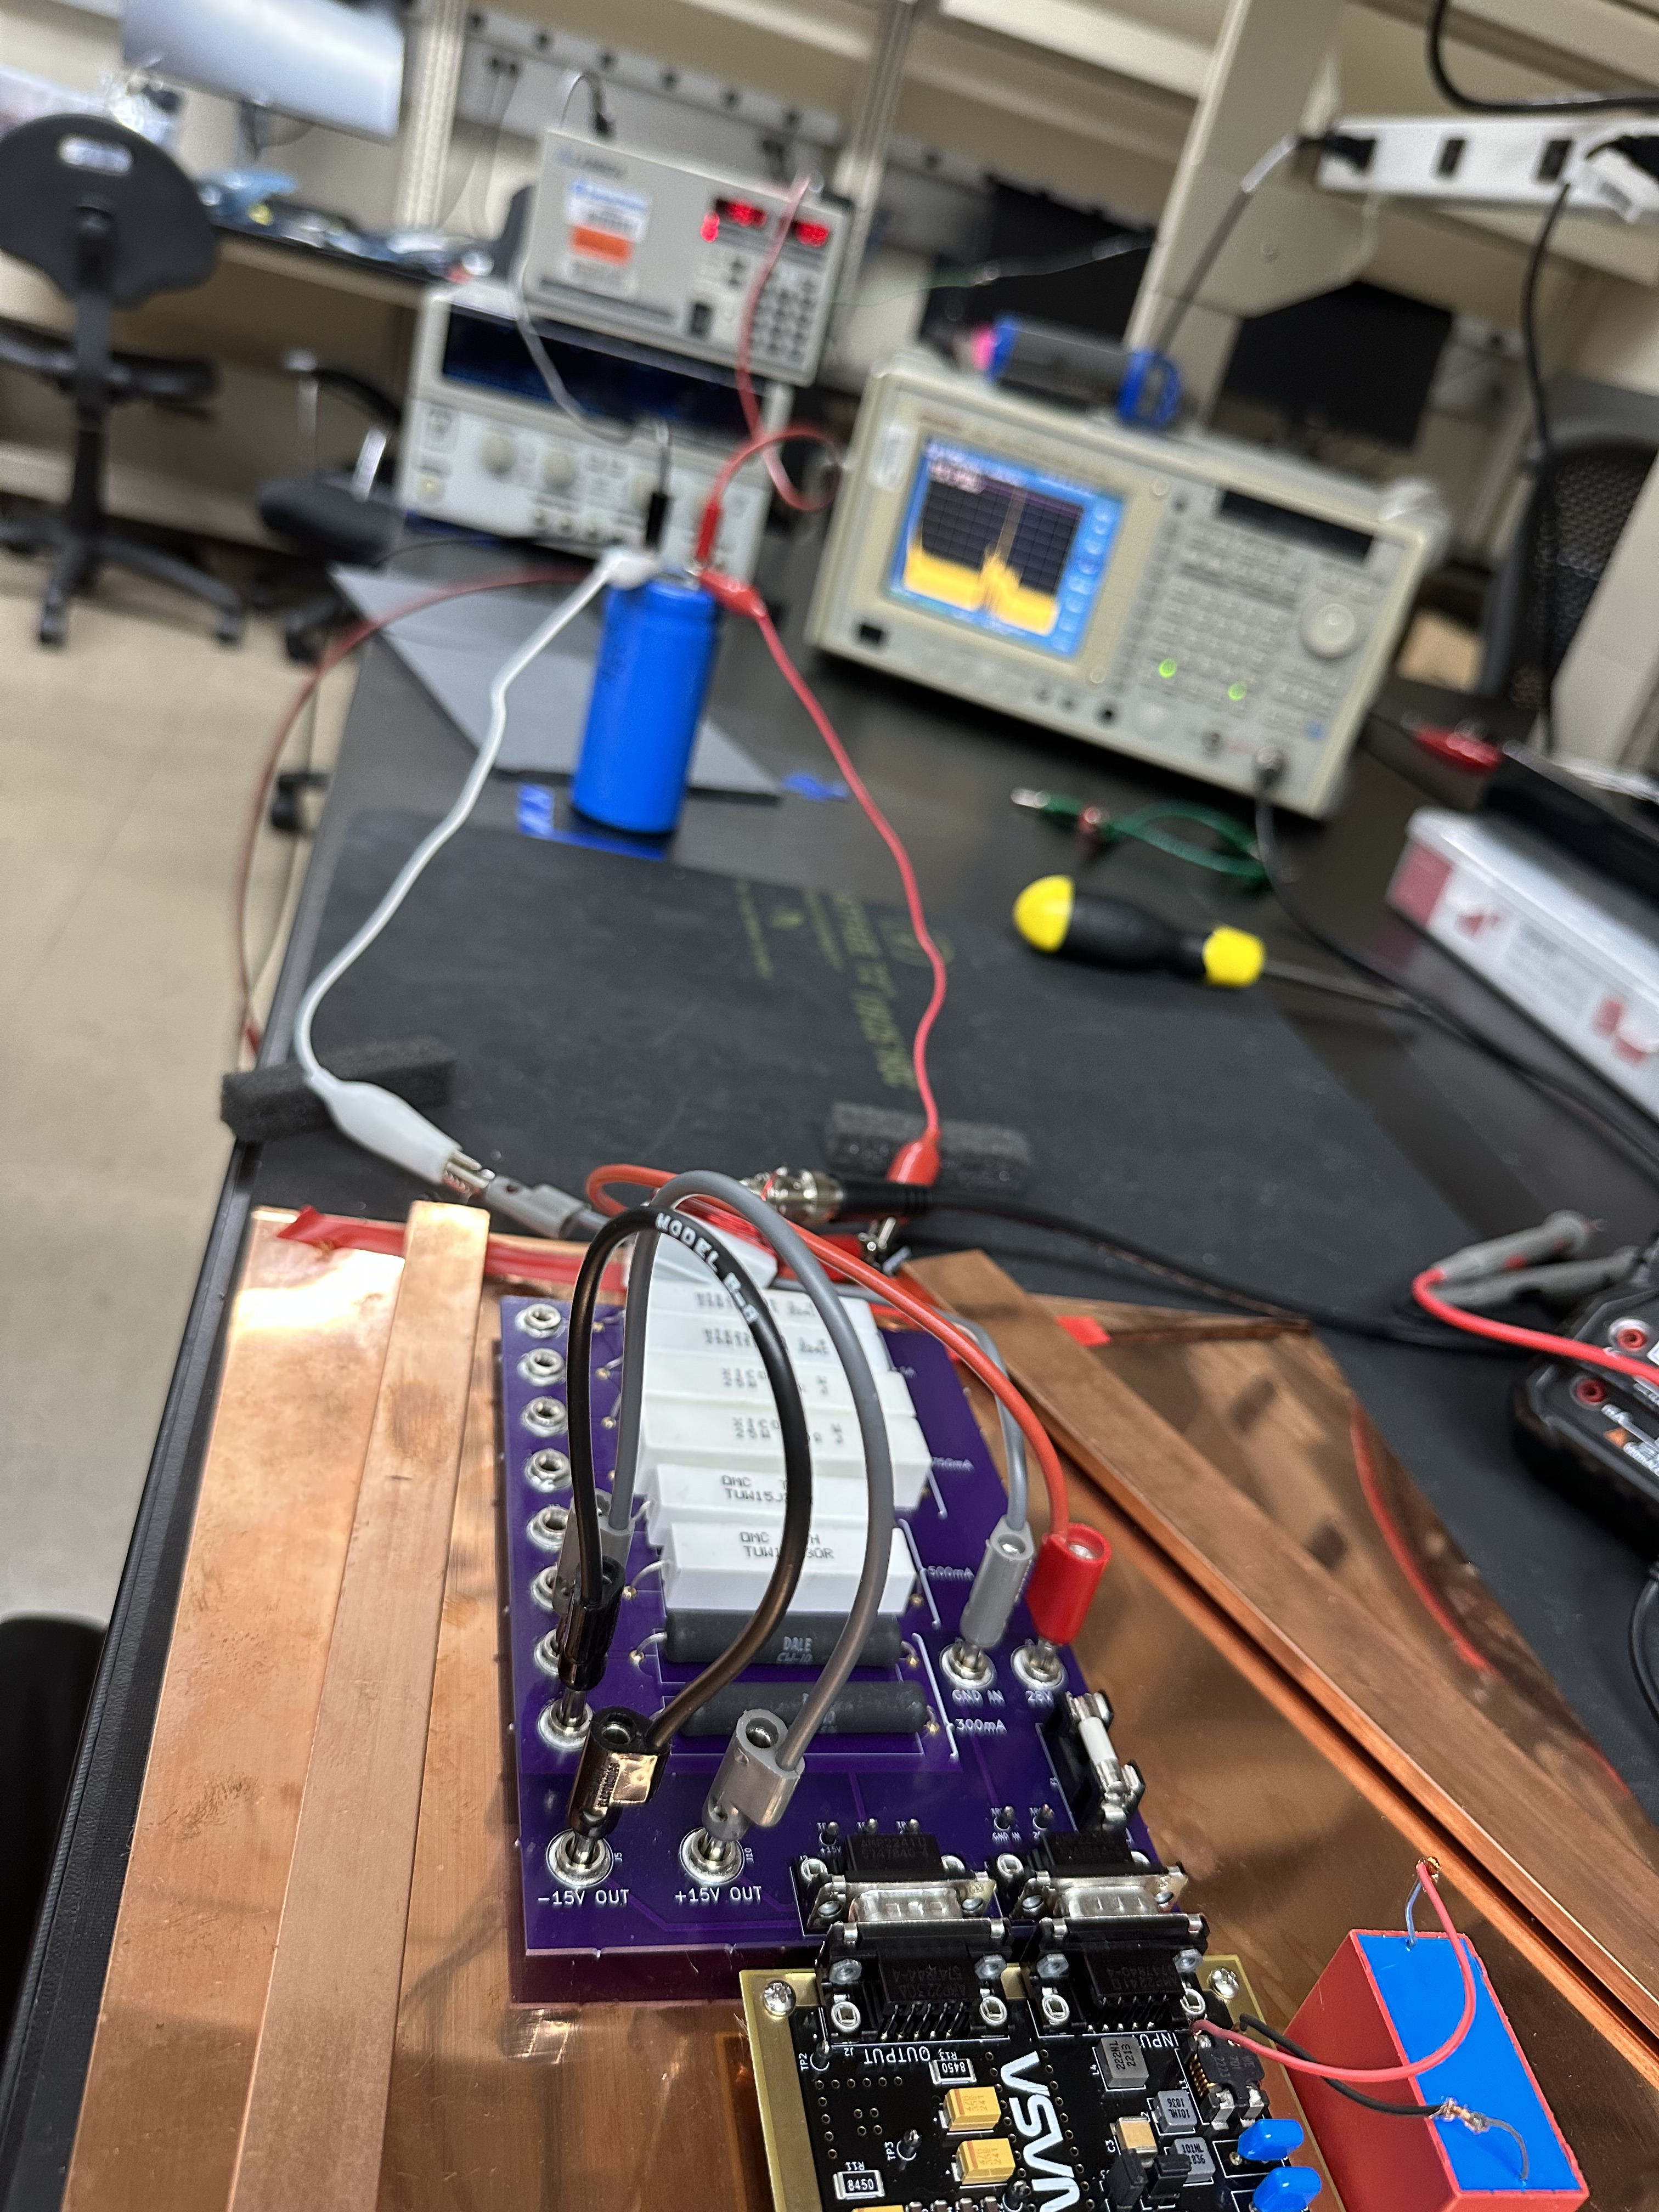
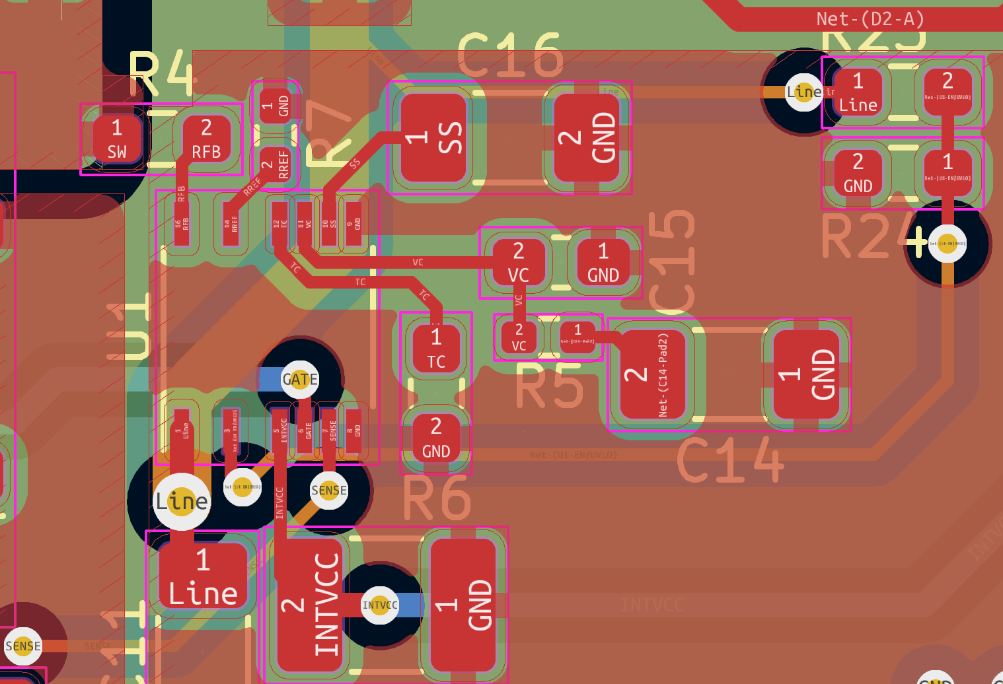
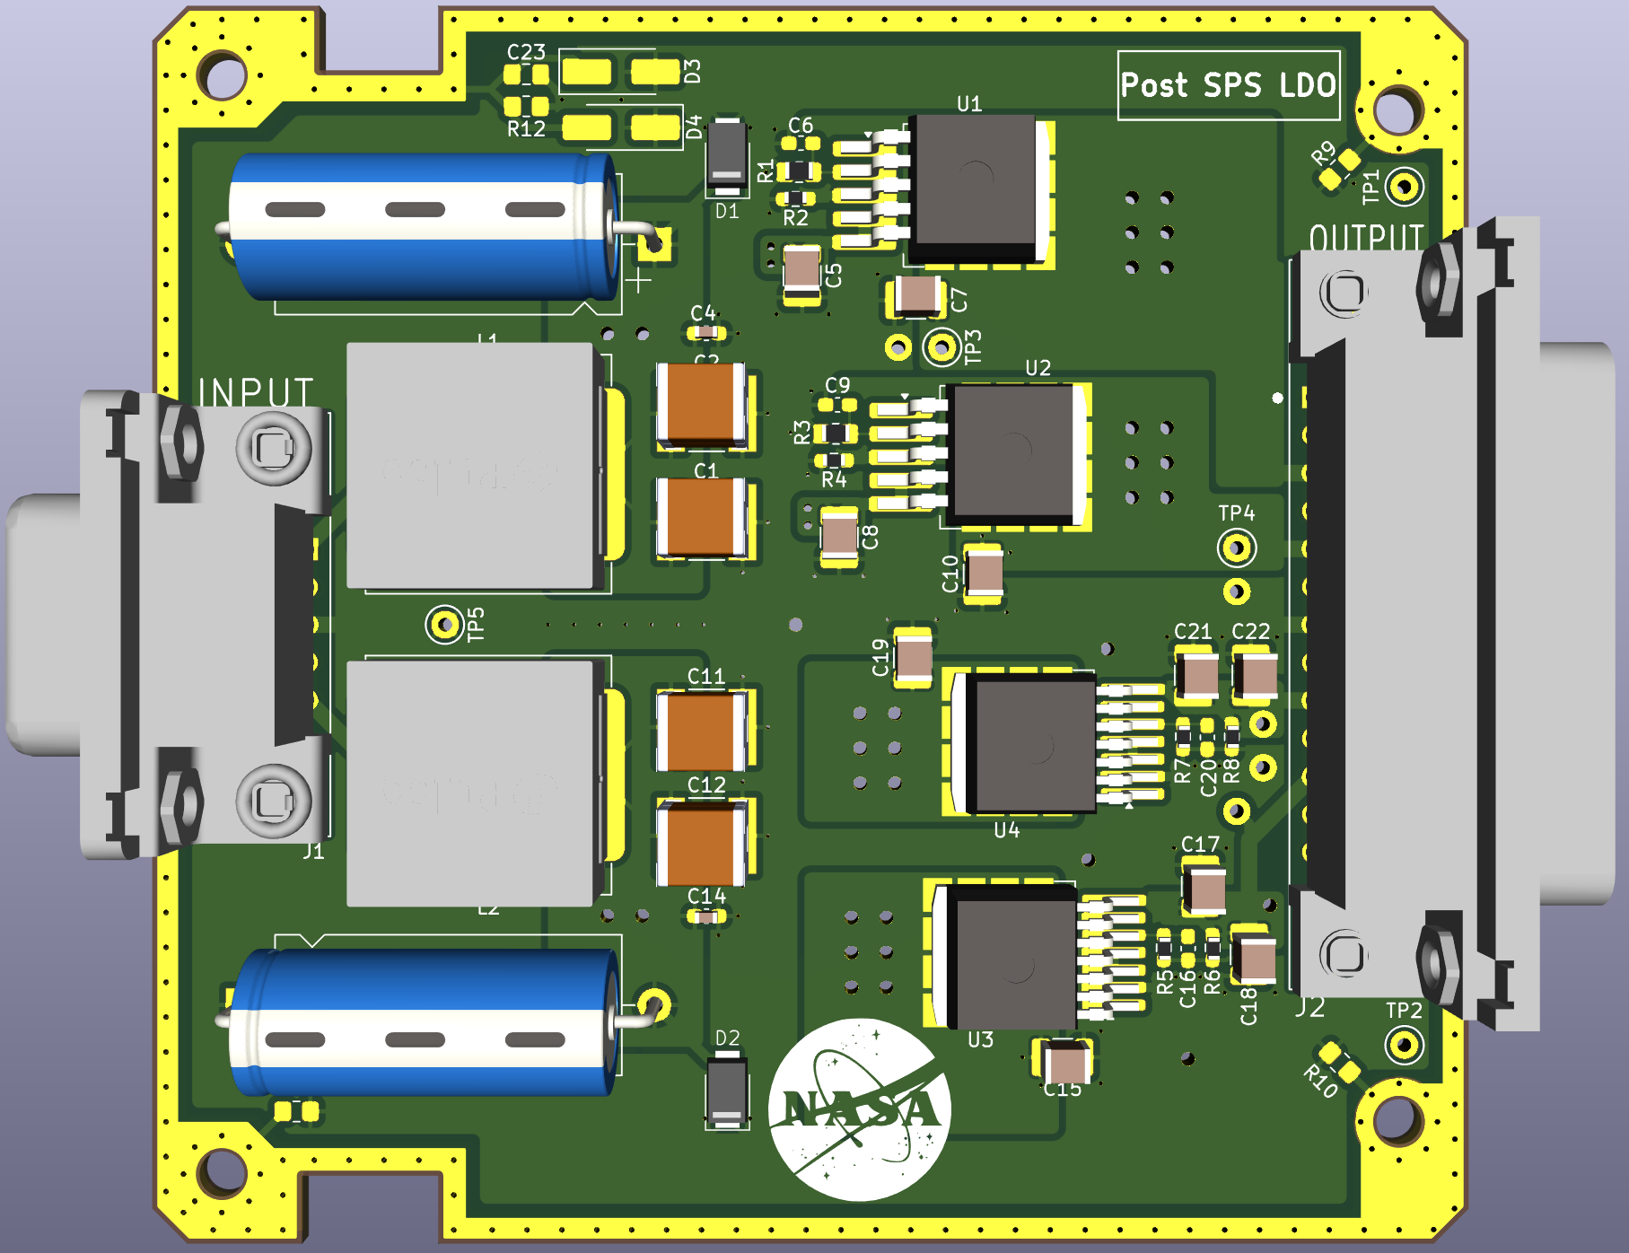
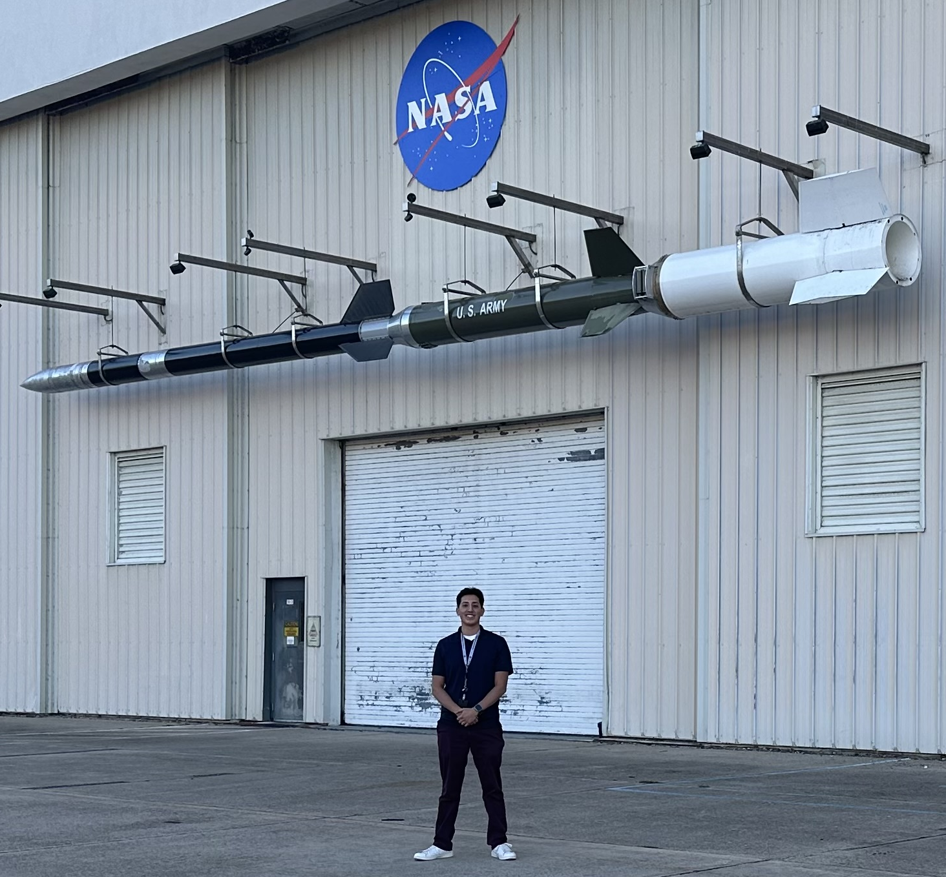
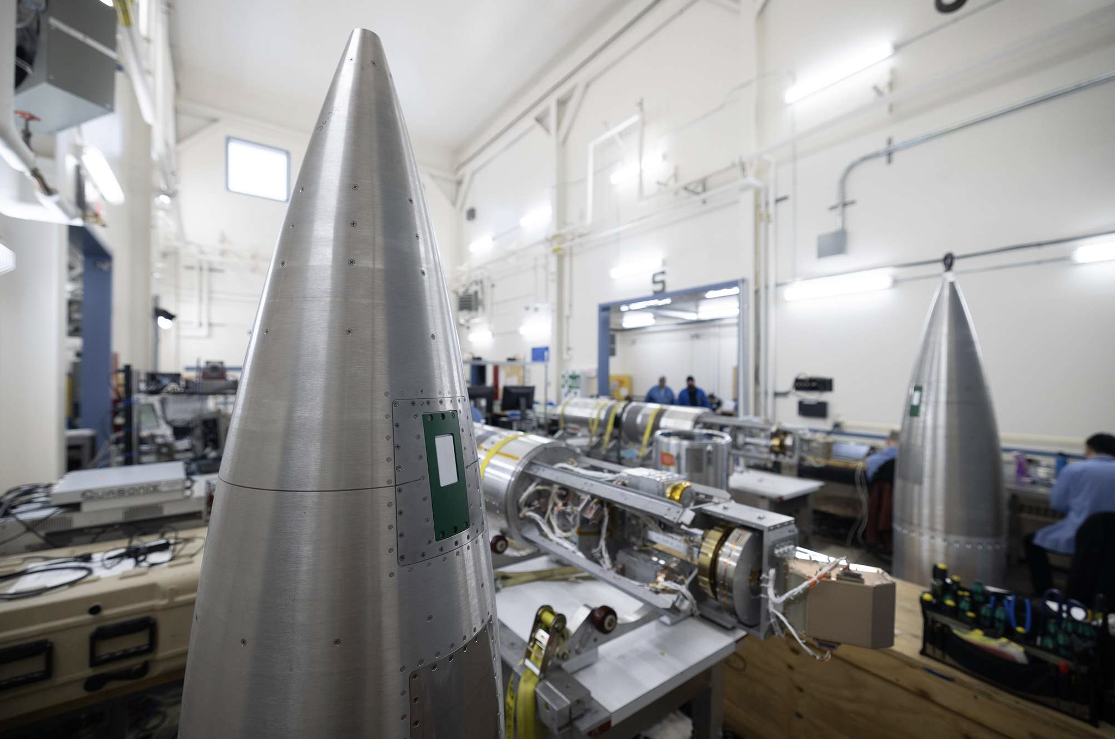
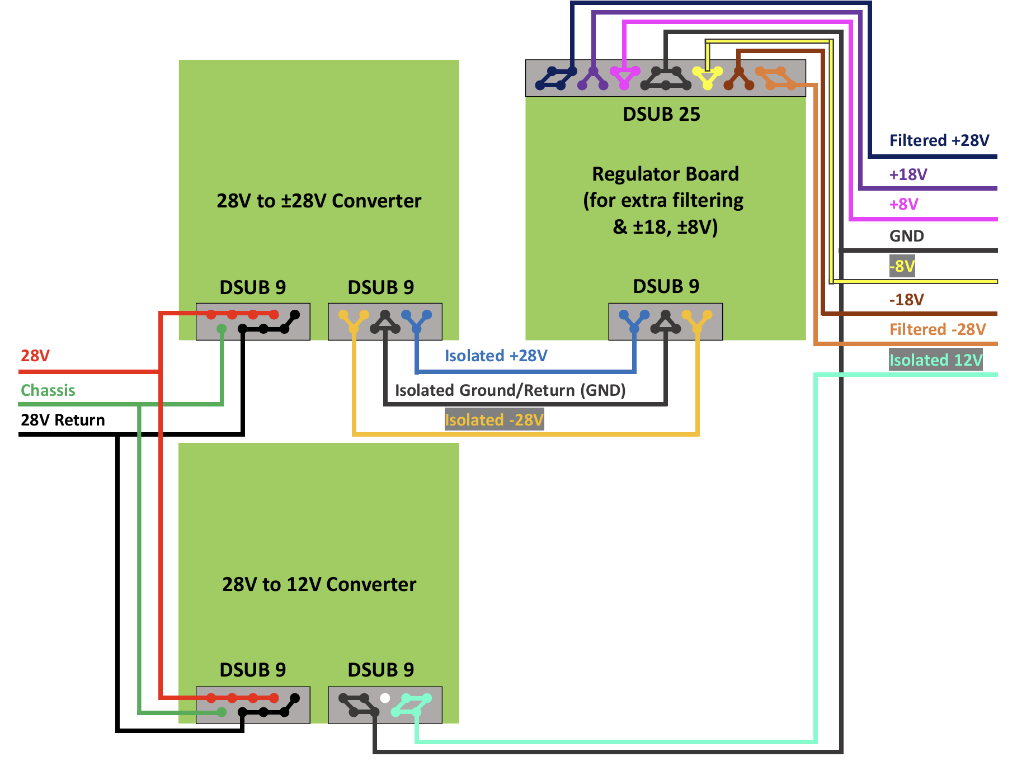
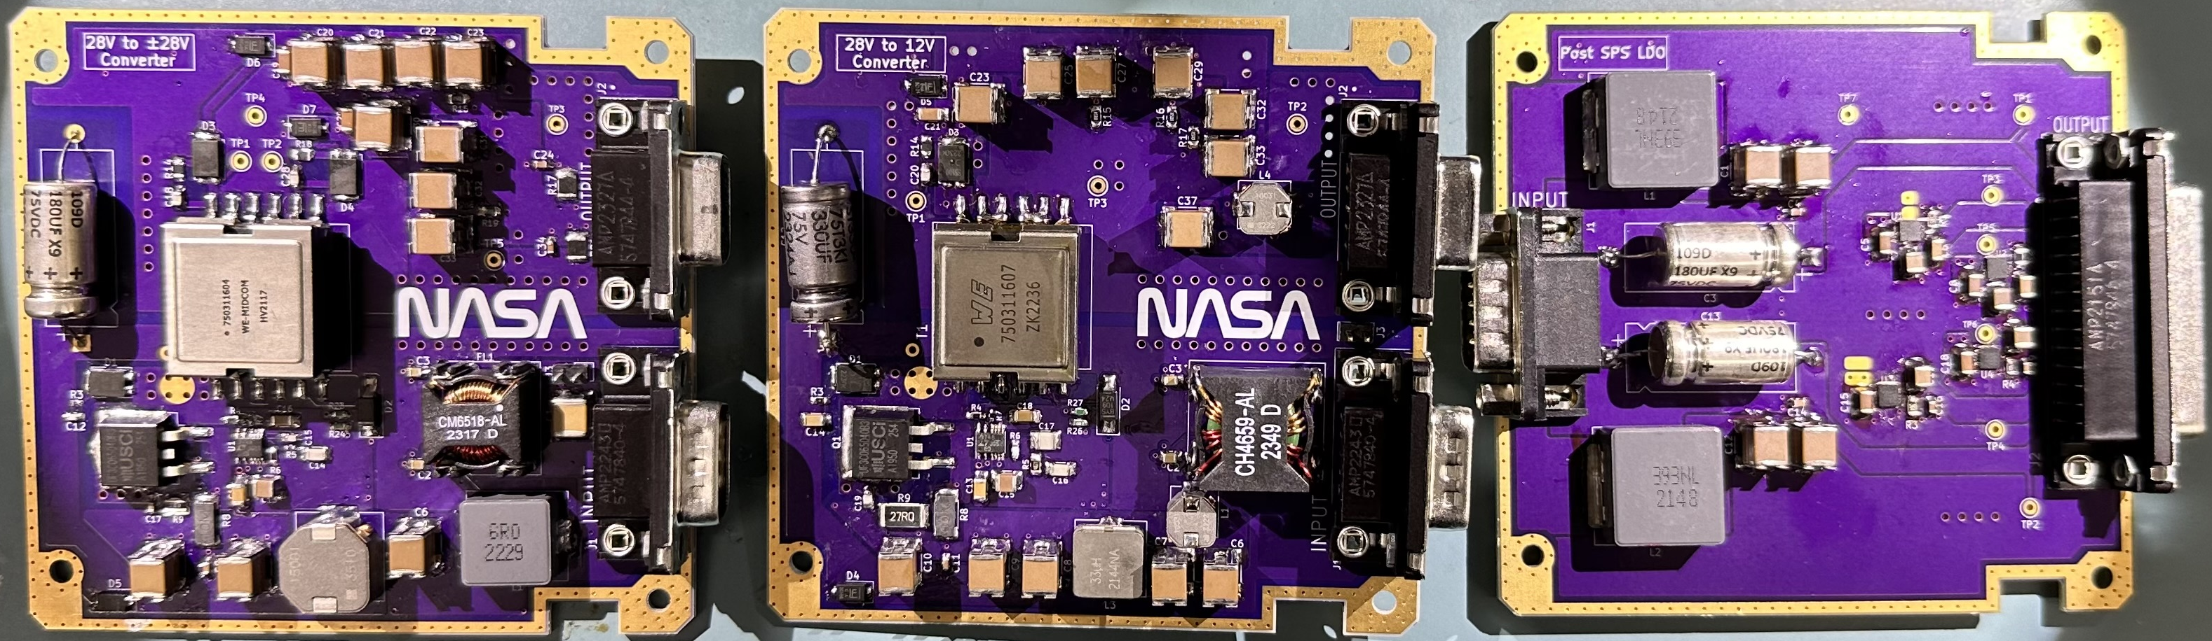
EMI Filtered Switched Mode Power Supplies for Sounding Rocket Applications
Author: Abraham Castaneda
Faculty mentor: Dr. R. Jacob Baker
NASA mentors: Dr. Marilia Samara, Adam J. Schoenwald
University of Nevada, Las Vegas | Department of Electrical and Computer Engineering
1. Overview
3. Methods
5. Results (continued)
Over the course of this project, I worked on the development, testing, and integration of space-grade power electronics in support of the Black and Diffuse Aurora Science Surveyor (BADASS) sounding rocket experiment, which aims to investigate the physics behind the optical variations within the aurora borealis
The specific hardware that was focused on were the printed circuit boards (PCBs) that would supply power to the charge-coupled device (CCD) instrument responsible for measuring auroral particles. This is a novel idea and the CCD instrument will be a technology demonstration on this sounding rocket experiment.
LTpowerCAD and LTspice were used to design and simulate the circuits under various input and loading conditions, which helped predict efficiency, output ripple, component stresses, and overall performance
KiCAD was used to produce the PCB layouts of the designs using footprints of commercial off-the-shelf (COTS) parts acquired from Mouser and DigiKey
EMI noise levels were measured using conducted emissions testing for differential and common mode noise, which
Goddard’s General Environmental Verification
Standard (GEVS) document covers in detail.
The LDO board had a unique issue where short circuits would develop underneath the voltage regulator chips, the cause of which was determined to be solder flux entrapment under the DFN packages used. As the regulators heated up from operation, flux residues left behind from assembly became conductive, causing leakage currents.
A respin of the LDO board (pictured lower right) that uses DDPAK packaged devices instead of DFNs resolved the issue
Since voltage regulators do not convert voltages as efficient as SMPS circuits do, heat losses were observed but expected. In the future, a set of converters may be used to improve efficiency at the cost of increased circuit complexity.
2. Introduction
4. Results
6. Conclusions
Switched-mode power supplies (SMPS), also referred to as DC-to-DC converters, are an integral part of sounding rocket missions, but their design can be complex, making them one of the most recurring design problems for NASA
SMPS are also known for producing significant amounts of electromagnetic interference (EMI), which needs to be removed with EMI filter circuits
The SMPS and EMI filters sold by aerospace vendors are very expensive and have long lead times, but custom designed boards with commercial-off-the-shelf (COTS) parts can be produced at a fraction of the time and cost
Three boards were designed to meet the needs of this project, a 28V to ±28V converter, 28V to 12V converter, and a low-dropout (LDO) regulator circuit to split the ±28V voltages into ±18V and ±8V. Each converter is fitted with an on-board EMI filter.
The DC-to-DC converters functioned as expected with the EMI filters successfully attenuating the nominal conducted emissions to acceptable levels
Both the 28V to ±28V and 28V to 12V boards operated with a power conversion efficiency of approximately 75%-80% under nominal loading conditions. Thermal issues that needed to be addressed involved the replacement of the output diodes with ones with higher current ratings as well as the adjustment of the snubber filters across the switching transistors (thermal image shows PCB heat signatures prior to these changes, courtesy of Alejandro Garcia Morilla)
Although the flyback topology that was used offers effective galvanic isolation from input to output, the transformer on the 28V to 12V board exhibited heat losses that required better heatsinking. A future design would either use a larger transformer or opt for a non-isolated topology (such as a buck converter)
With all of the power electronics assembled and flight ready, they were successfully installed into the sounding rocket by the team at NASA’s Wallops Flight Facility, where I was also able participate in payload integration for the GIRAFF rocket mission and witness sequence testing of the BADASS system
Although the aurora this season did not yield the desired conditions for the launch of BADASS, the team is hopeful to launch next year
Acknowledgments
This material is based upon work supported by the NVSGC under Grant No. 80NSSC20M0043

