Slide 1
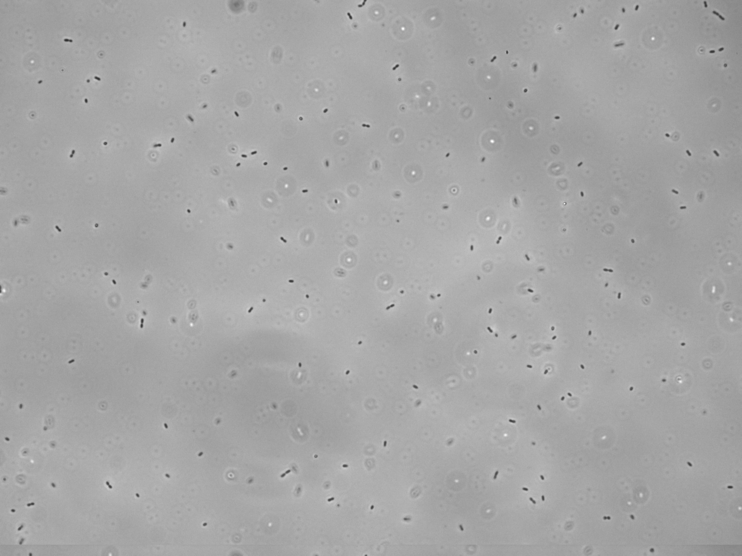



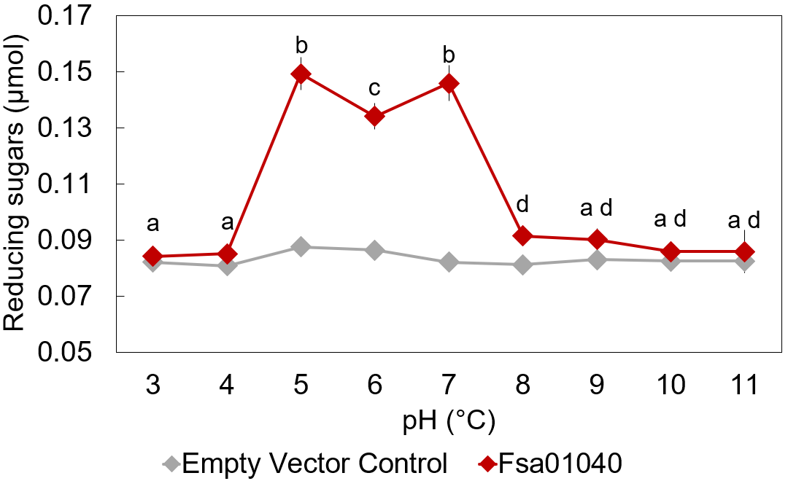
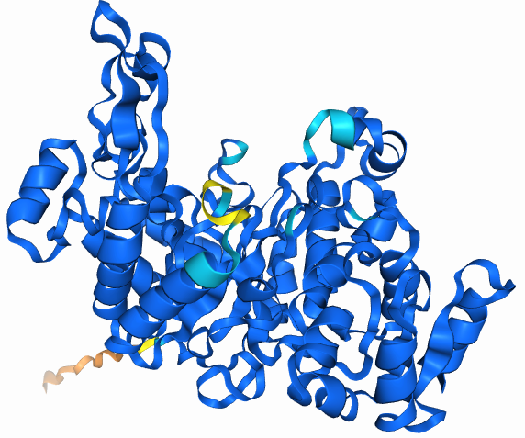
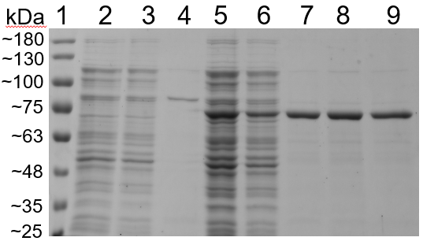
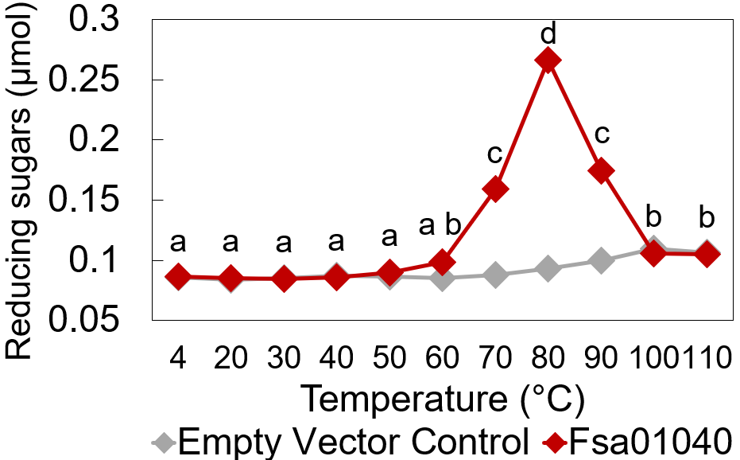
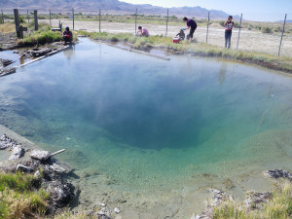
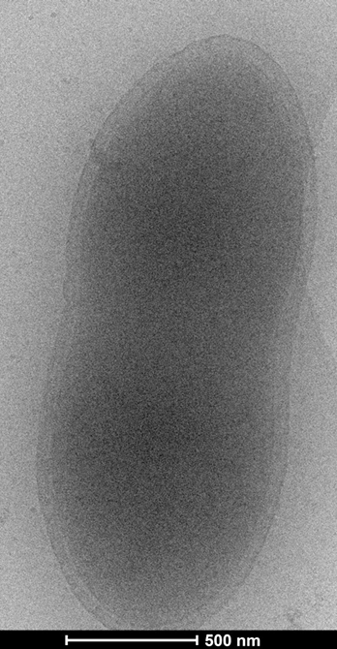
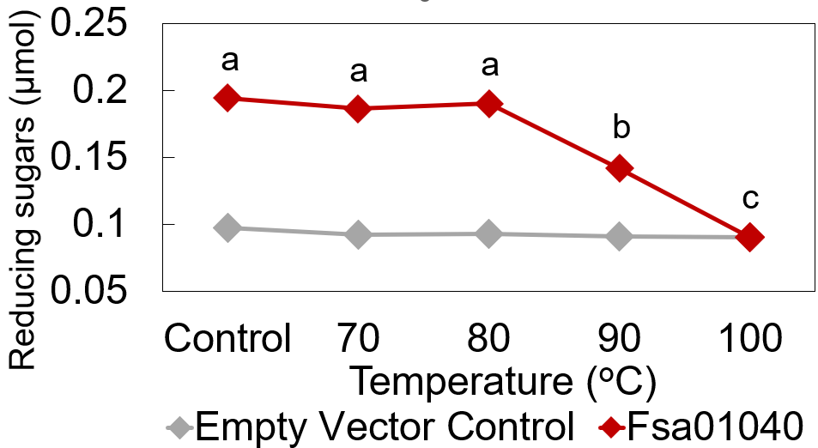
Determining the Activities and Optimal Conditions of Fsa01040Cel, a Hyperthermophilic GH5 Family Enzyme From Fervidibacter sacchari
Allison M. Cook¹, Nicole Torosian¹, Jonathan K. Covington¹,Nancy O. Nou¹, Marike Palmer², Ian K. Blaby³, Brian P. Hedlund¹
¹ School of Life Sciences, University of Nevada Las Vegas, Las Vegas, NV, USA, ² Department of Microbiology, University of Manitoba, Winnipeg, MB, Canada, ³US Department of Energy Joint Genome Institute, Lawrence Berkeley National Laboratory, Berkeley, CA, USA This material is based upon work supported by NASA under Grants No. 80NSSC20M0043 and 80NNSC17KO548,and NSF under Grant No. DEB 1557042
ABSTRACT
Fervidibacter sacchari is found in Great Boiling Spring, a terrestrial geothermal hot spring and grows on multiple plant polysaccharides utilizing up to 117 putative glycoside hydrolases. Enzyme Fsa01040Cel from F. sacchari is in the glycoside hydrolase family 5. The gene was synthesized, cloned into pET-21b, and heterologously expressed using Escherichia coli strain T7 Express cells. temperature range of 60-90 °C (T_{opt} 80 °C), thermostable to 90 °C, and a pH range between 4.5-7.5 (pH_{opt} 5.0, 7.0). Phylogenetic analysis of Fsa01040Cel showed the evolutionary relationships to GH family 5_1. Determining the activities of Fsa01040Cel can assist in understanding life in extreme environments and the contributions of extremophiles such as F. sacchari to science.
METHODS
Gene Expression and Purification
Transformed E. coli coding for Fsa01040Cel and E. coli without a cloned GH gene (negative “empty vector” control) were used.
The cells were grown in LB broth with 50 µg/mL ampicillin, shaking at 225 rpm at 37 °C to OD₆₀₀ of 0.6‒0.8.
IPTG was added to a concentration of 0.5 mM to induce expression of Fsa01040Cel and incubated overnight at 37 °C.
Cells were harvested by centrifugation, resuspended in lysis buffer, lysed by sonication. Soluble fractions were isolated from the crude lysates by centrifugation to remove cell debris.
Soluble lysates were purified using HisPur™ Ni-NTA Spin columns and stored at -20 °C.
Concentration, purity, and size verification.
1. Soluble fractions and purified enzymes were run on an SDS-PAGE.
2. The gel was stained with Coomassie Brilliant Blue G-250 overnight and destained for 1 hour.
3. The gel was imaged using an Amersham Typhoon 5 Biomolecule scanner.
Temperature range, Thermostability, and pH range
Activity was determined by DNS assays with 3.42 μg enzyme and 20 μL of 0.5% w/v CMC.
Activity was measured by incubating the mixtures at temperatures ranging from 4-110 °C for 16 hours.
Figure 6: pH Activity
A pH range of 4.5 to 7.5 was exhibited with optimal activity at 5.0 and 7.0.
Figure 7: Computed Structure Model
Predicted structure of Fsa01040Cel with a pTM of 0.93.
CONCLUSION
With an abundance of glycoside hydrolases the genome of Fervidibacter sacchari, characterizing the functions of enzymes such as Fsa01040Cel can aid in the production of biofuels from biomass. Fsa01040Cel functions as a polysaccharide degrader of cellulolytic materials, with carboxymethyl cellulose showing the greatest amount of reducing sugars produced. The optimal temperature for this enzyme is 80 °C and the optimal pHs are 5.0 and 7.0 showing a bifurcation in the data with a wider range of potential industrial applications. Fsa01040Cel is temperature stable prior to use from -20 °C to 90 °C. Protein purification exhibited an average of > 97% pure when using HisPur™ Ni-NTA Spin columns. Phylogenetics showed the closest GH5 relatives of Fsa01040Cel to be in subfamily 1 which are all endo-β-1,4-glucanases according to information from the CAZy database.
INTRODUCTION
Fervidibacter sacchari is an aerobic hyperthermofilic bacterium (T_{opt} ≥ 80 °C) isolated from the sediment of Great Boiling Spring, Nevada, and the only member of class Fervidibacteria grown as a pure culture. F. sacchari specializes in polysaccharide metabolism, using at least 16 polysaccharides sole sources of carbon and energy. The genome of F. sacchari contains 117 genes with one or more glycoside hydrolase (GH) domains encompassing 49 different GH families.
Fsa01040Cel is a cellulase (endo-β-1,4-glucanase) in F. sacchari that can hydrolyze glycosidic bonds reducing polysaccharides into monosaccharides. Degrading biomass waste into monosaccharides allows for production of renewable biofuels through fermentation of these simple sugars. Sustainable energy sources such as biofuels can be produced at the industrial level to meet energy needs while reducing emissions and greenhouse gasses.
Figure 1: Great Boiling Spring
Source of Fervidibacter sacchari
isolate.
RESULTS
Figure 3: SDS-PAGE Gel
Protein Ladder
2,3) Empty vector control
4) Purified empty vector control
5,6) Fsa01040Cel lysate
7-9) Purified Fsa01040Cel lysate > 97% pure and 68 kDa.
Figure 4: Temperature Range Activity
Amount of reducing sugars created from 3.42 μg Fsa01040Cel and 0.5% w/v CMC from 4-110 °C.
ACKNOWLEDGEMENTS
This material is based upon work supported by NASA under Grants No. 80NSSC20M0043 and 80NNSC17KO548, and by NSF under Grant No. DEB 1557042.
This material is based upon work supported in part by the Office of Science of the U.S. Department of Energy under contract No. DE-AC02-05CH11231.
Figure 5: Thermostability
Fsa01040 was determined to be stable up to 90 °C with the highest amount of activity at 80 °C.
Figure 2: Cell Structure
Cryo-electron micrograph
of a F. sacchari cell.

