Slide 1


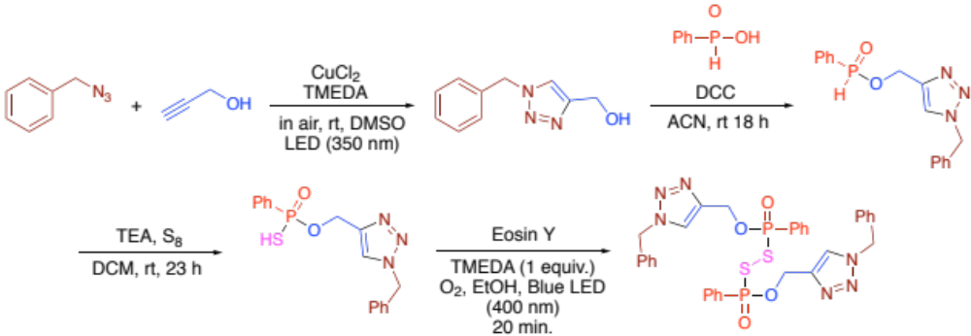
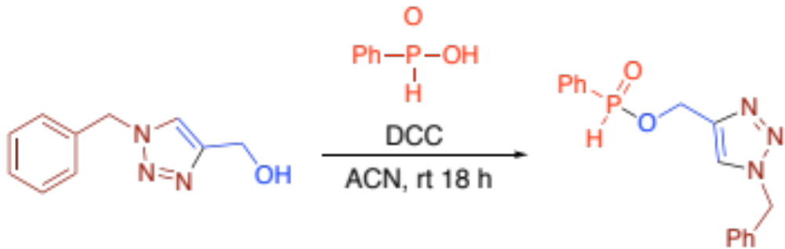
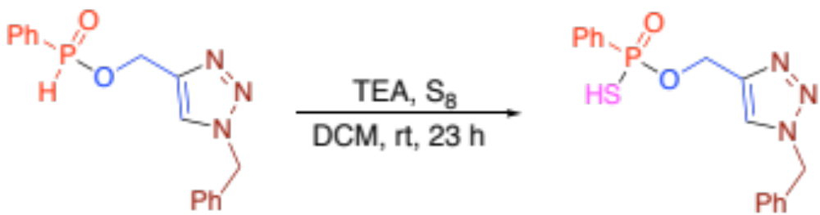
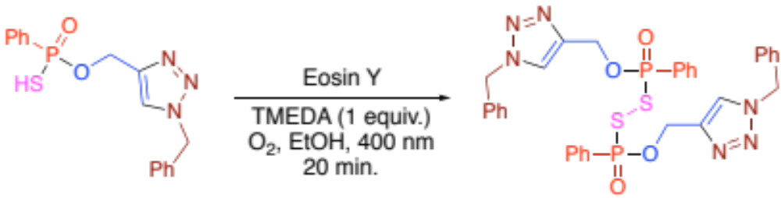
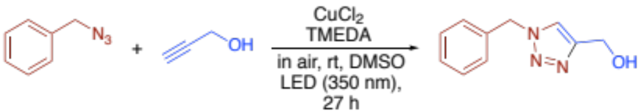
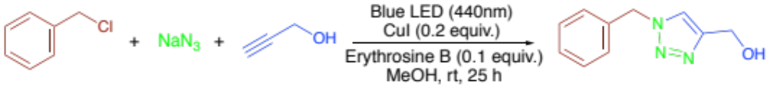
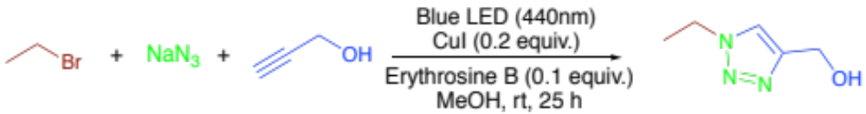
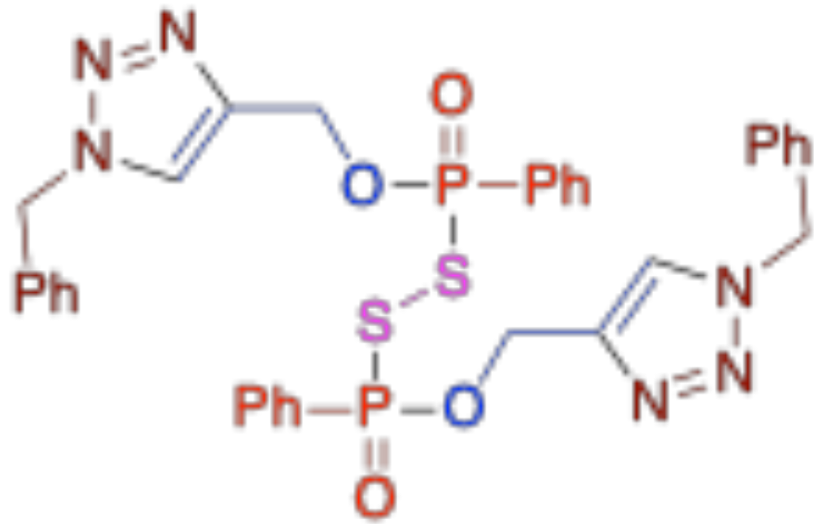
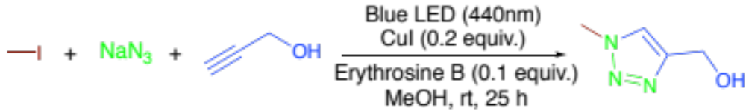
Synthesis of Disulfide Triazole Organophosphate, Flame Retardant, via Photochemistry
Jonathan Le - University of Nevada Las Vegas, Student
Dr. Jun Yong Kang - University of Nevada Las Vegas, Mentor
Overview
Method
Results cont.
This research develops a disulfide triazole organophosphate (DSTP) flame retardant via flow photochemistry, enhancing fire resistance and environmental safety. Integrating phosphorus, sulfur, and triazole moieties, the design improves thermal stability and reduces toxicity. Using light-induced reactions and a modular synthetic strategy, the study supports NASA’s Fire Protection Program and Green Chemistry principles. The findings advance sustainable flame retardants for aerospace and industry, showcasing flow photochemistry’s potential for safer, high-performance materials.
64%
47%
Results
Introduction
This study proposes the synthesis of a disulfide triazole organophosphate (DSTP) flame retardant via flow photochemistry as a safer, sustainable alternative to banned halogenated flame retardants. The DSTP design integrates phosphorus for radical neutralization, sulfur for thermal stability, and triazole moieties for environmentally benign decomposition into nitrogen gas (N₂). The synthesis follows a modular strategy for efficiency, selectivity, and scalability. Benzyl azide and propargyl alcohol undergo light-induced copper(I)-catalyzed click chemistry, forming a triazole intermediate that reacts with phenyl phosphonic acid via nucleophilic substitution. After sulfurization with elemental sulfur, the final disulfide bridge is established through Eosin Y-mediated photocatalytic aerobic oxidation. This metal-free, photochemically driven approach reduces toxicity and aligns with Green Chemistry principles. Experimental evidence confirms the stability, efficiency, and environmental safety of DSTP, demonstrating its potential as a high-performance flame retardant. The research supports NASA’s Fire Protection Program and advances flow photochemistry as a scalable method for sustainable material synthesis in aerospace and industrial applications.
No Reaction
In Progress
Conclusion
The results satisfy the research objective by showcasing the capabilities and flexibility of photochemical synthesis in the first step, demonstrating an environmentally friendly approach with potential to refine and expand synthetic methodologies for efficient DSTP production. Our findings demonstrate photochemical triazole synthesis and its adaptability for structural modifications. Additionally, adjusting benzyl chloride by reducing carbon content and hydrogen bonds enhances fire-retardant efficiency by limiting fuel for combustion.
73%
17%
Acknowledgements
73%
This material is based upon work supported by NVSGC under Grant No. 80NSSC20M0043. We are grateful to Nevada Space Grant Consortium (NVSGC) for financial support and Shishir Bhowmik, Parsa Azalea, and Arjae Aroc-Villanueva for their guidance and support.

