Slide 1



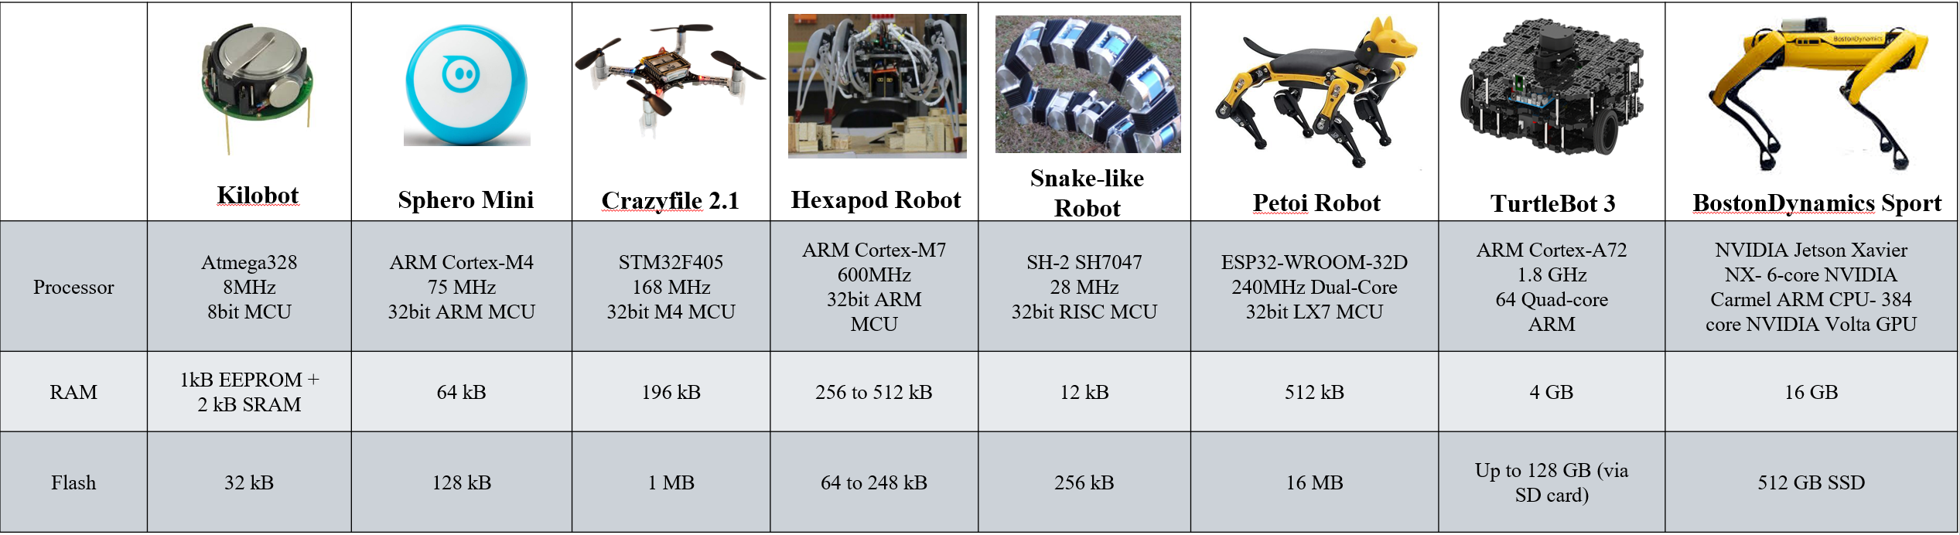
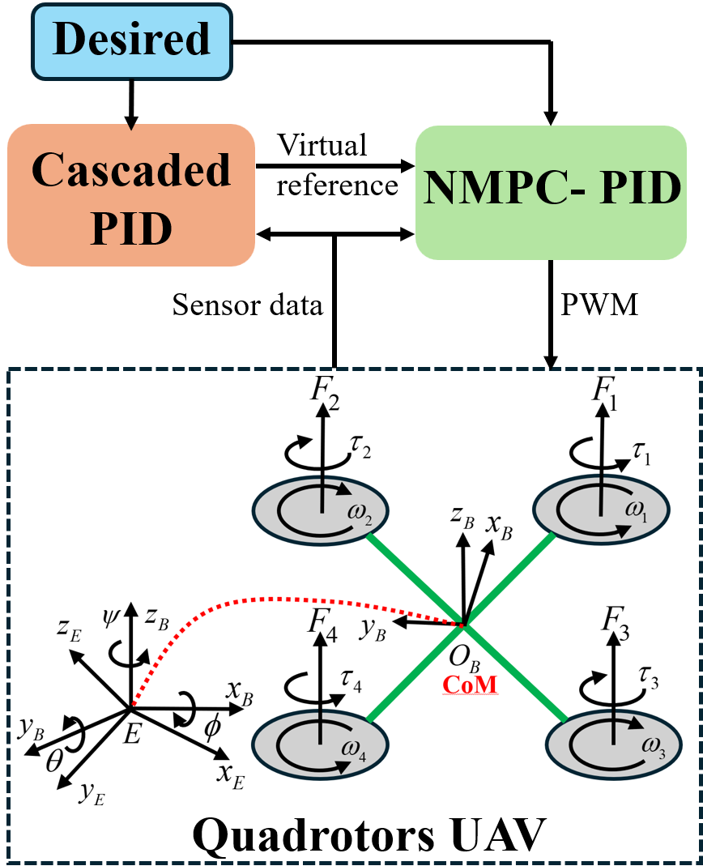
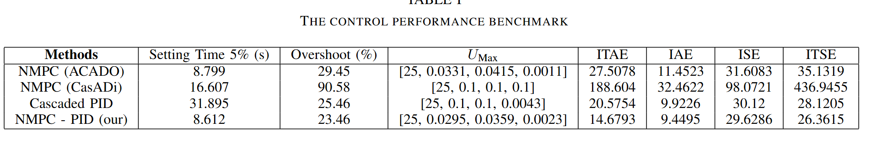
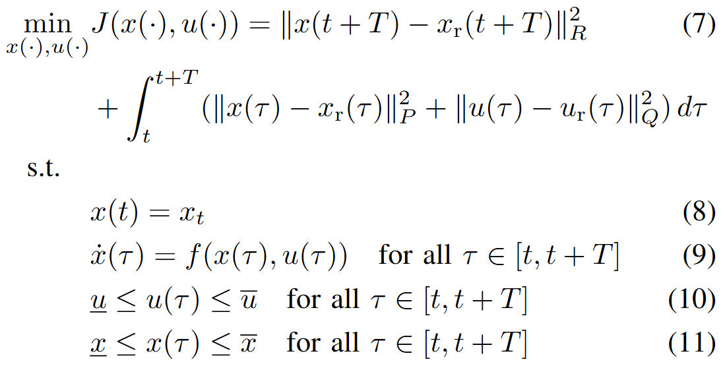
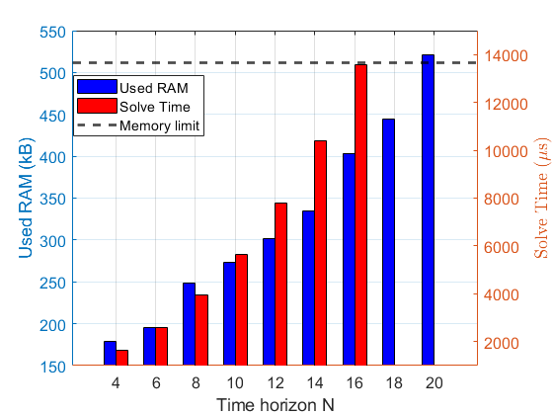
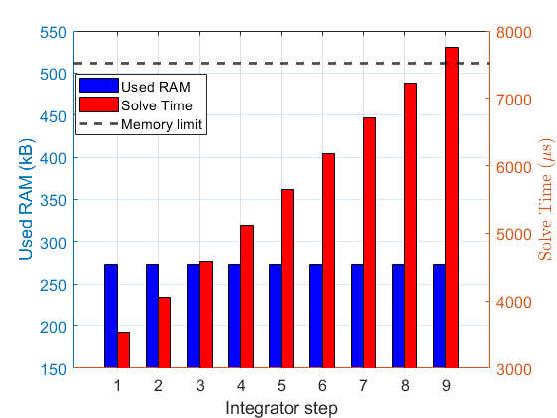
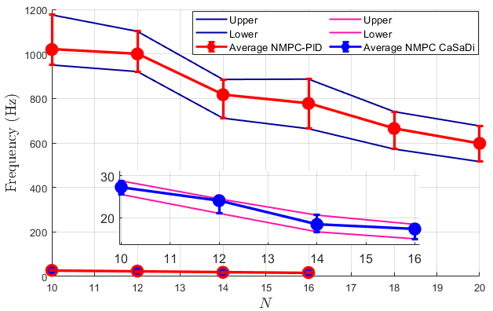
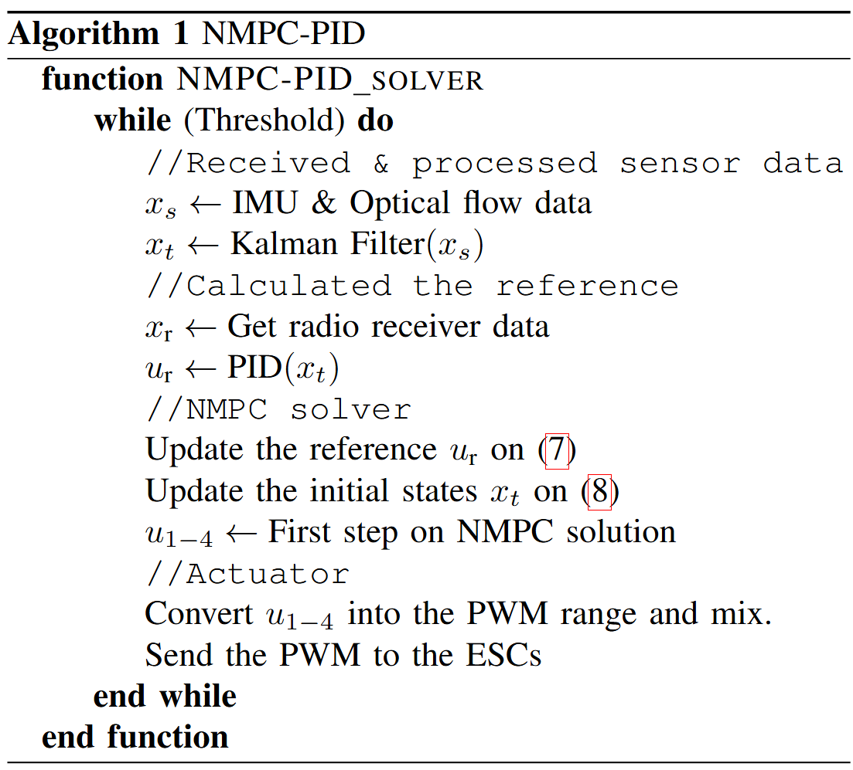
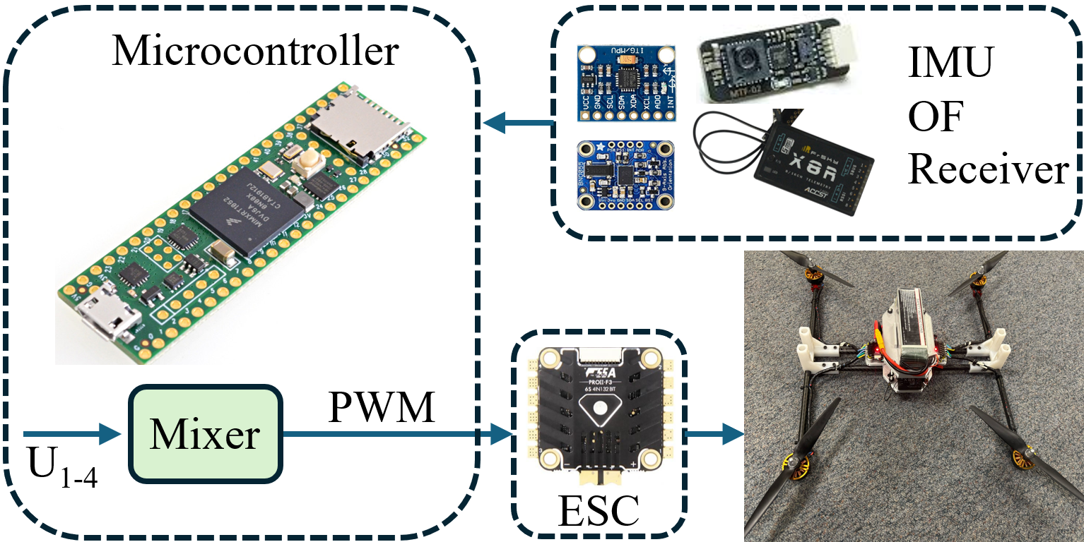
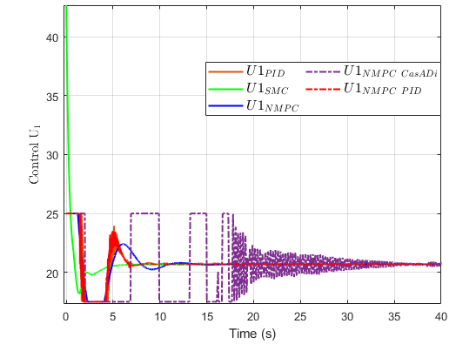
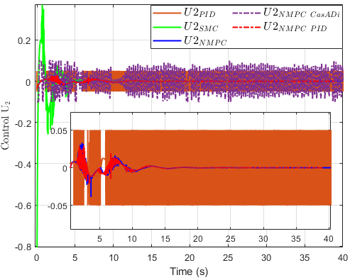
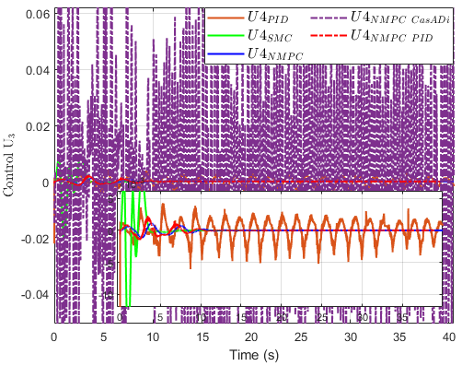
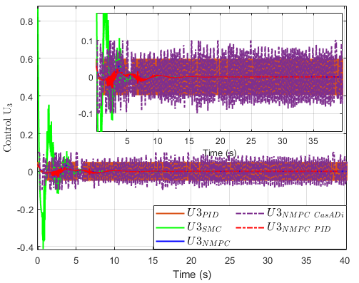
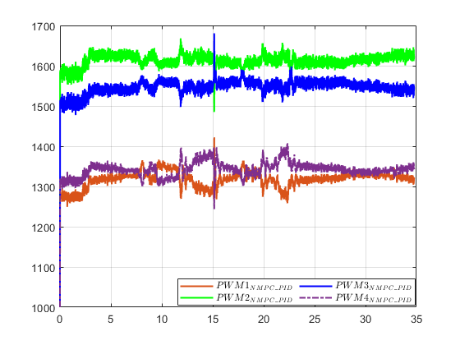
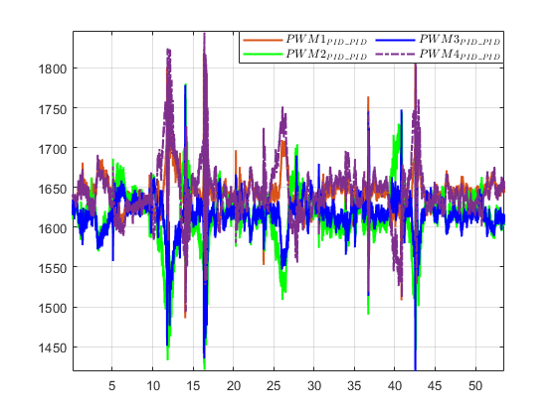
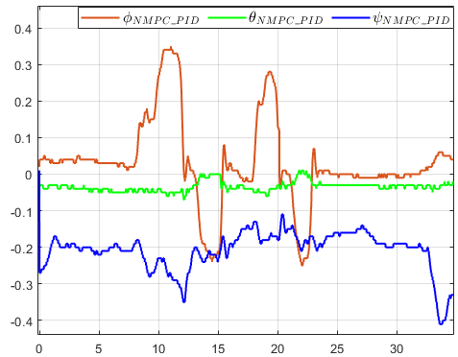
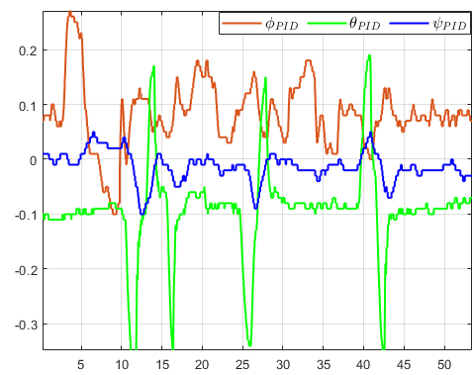
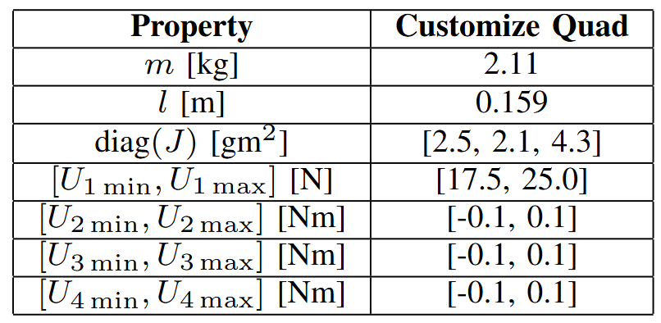
NASA EPSCoR
Nonlinear Model Predictive Control based PID
on Resource-Constrained Microcontrollers
Van Chung Nguyen, Pratik Walunj, Hung Manh La
Abstract
Introduction
Conclusion
Nonlinear Model Predictive Control (NMPC) is a powerful approach for controlling highly dynamic robotic systems, as it accounts for system dynamics and optimizes control inputs at each step. However, its high computational complexity makes implementation on resource-constrained microcontrollers impractical. While recent studies have demonstrated the feasibility of Model Predictive Control (MPC) with linearized dynamics on microcontrollers, applying full NMPC remains a significant challenge. This work presents an efficient solution for generating and deploying NMPC on microcontrollers to control quadrotor UAVs. The proposed method optimizes computational efficiency while maintaining high control accuracy. Simulations in Gazebo/ROS and real-world experiments validate the effectiveness of the approach, demonstrating its capability to achieve high-frequency NMPC execution in real-time systems.
We present an embedded NMPC-PID framework designed for resource-constrained microcontrollers, specifically applied to quadrotor UAVs. The PID controller provides an initial solution for the optimization problem, while the nonlinear dynamics of the system are addressed using the ACADO code generation tool and the qpOASES solver. The embedded code, running on a Teensy 4.1 microcontroller, achieves high-frequency performance, demonstrating its practicality for real-time systems. In real-time experiments, the NMPC-PID framework not only achieves high-frequency computation on a single microcontroller but also successfully stabilizes the quadrotor UAVs while satisfying input constraints. This highlights the effectiveness and efficiency of the proposed approach in real-world applications. In the future, we plan to incorporate an additional layer using potential field or optimal-time optimization for navigation, which will consider obstacle avoidance and external disturbances to enable the autonomous operation of the system.
Methodology
Results
Simulations
Experiments
Acknowledgment
System & Control parameters
This work is supported by NASA EPSCoR under grant number 80NSSC24M0141. The views, opinions, findings, and conclusions reflected in this publication are solely those of the authors and do not represent the official policy or position of NASA EPSCoR.
The authors are with the Advanced Robotics and Automation (ARA) Lab, Department of Computer Science and Engineering, University of Nevada, Reno, NV 89557, USA.

