Slide 1



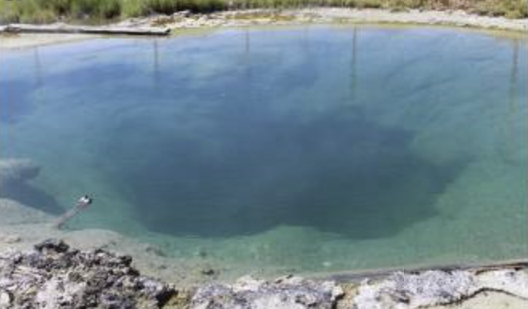
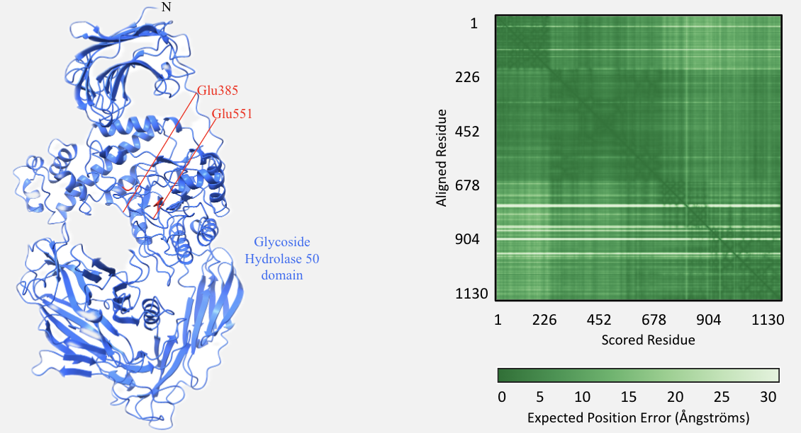
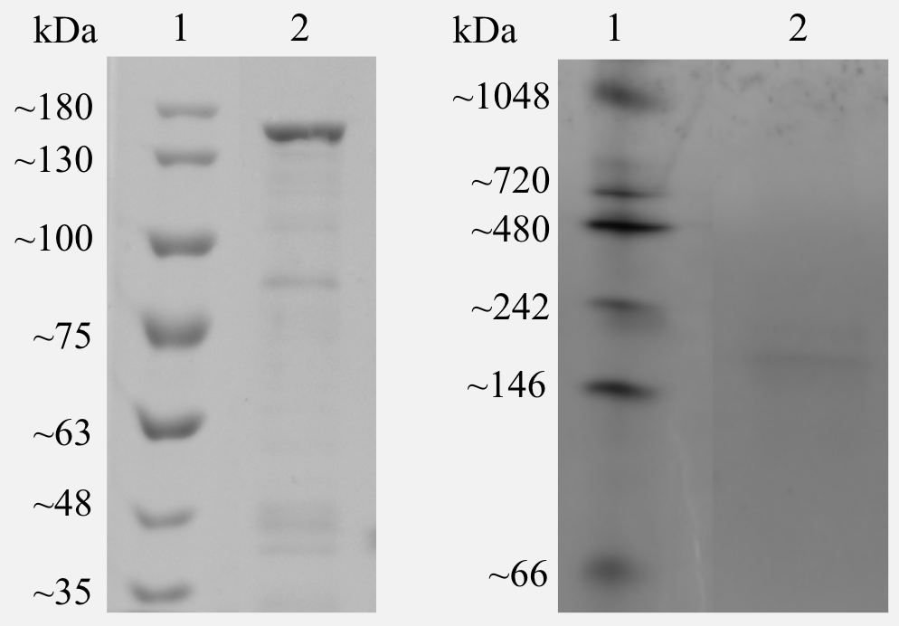
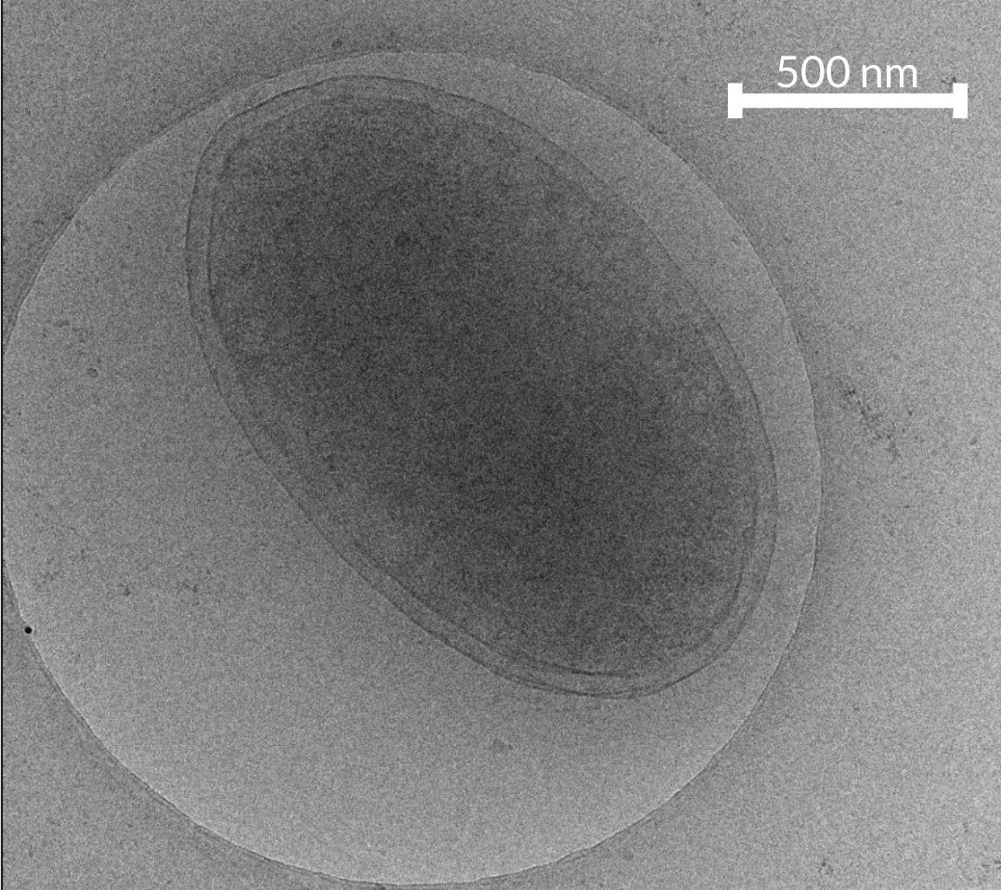
Characterization of a gellan gum-degrading enzyme from hyperthermophile
Fervidibacter sacchari
Janalee J. Vaseur, Jonathan K. Covington, Allison M. Cook, Savannah R. Sleezer, Brian P. Hedlund, Ian Blably
School of Life Sciences, University of Nevada, Las Vegas, Las Vegas Nevada
Overview
Methods
Fervidibacter sacchari, an aerobic hyperthermophile capable of degrading various polysaccharides, is the first member of the class Fervidibacteria within the phylum Armatimonadota to be cultured. Its genome encodes 117 predicted glycoside hydrolases (GHs), including two from GH family 50 (GH50). In this study, one of these GH50 enzymes, Fsa11540Glu, was expressed, purified, and functionally characterized. Electrophoresis confirmed the molecular weight at ~137 kDa and suggested the enzyme is a monomer. ColabFold computed structure models (CSMs) also predicted a monomer and identified a putative active site with conserved active site residues Glu385 and Glu551. A screen for GH activity against 12 substrates revealed activity on gellan gum, β-glucan, carboxymethyl (CM) curdlan, and agarose. Despite most GH50s being known for being β-agarases, Fsa11540Glu was optimally active on gellan gum. The enzyme was thermostable for at least one hour at 90 ºC. The optimal temperature was 80-90 ºC and the optimal pH was 5.5.
An E. coli codon frequency table was used for codon optimization of the gene encoding Fsa11540Glu (Oberortner et al., 2016).
The codon-optimized Fsa11540Glu gene was synthesized with an N-terminal 6 × His tag, a GB1 solubility tag, and a TEV protease cleavage site. The synthetic gene was ligated and cloned in pET-21b-GB1 within E. coli T7 Express cells.
Computed structure models (CSMs) were generated to visualize the structure of Fsa11540Glu and amino acid positions of the two conserved glutamic acid residues within ChimeraX v 1.8 using AlphaFold 3 (Figure 3).
The transformed E. coli cells were grown on Luria-Bertani (LB) agar plates with 100 µg/mL ampicillin then transferred to LB broth with 100 µg/mL ampicillin for incubation at 37 ºC and shaking at 225 rpm until reaching OD₆₀₀ of 0.6‒0.8. Isopropylthio-β-galactoside (IPTG) (0.5 mM ) was added before incubating overnight at 37 °C with shaking at 150 rpm. The cells were centrifuged at 16,100 x g, resuspended in lysis buffer, and lysed by sonication. The soluble fraction was isolated by centrifugation and the crude lysate was removed.
Fsa11540Glu was heat purified by heating the crude lysate at 80 ºC for 30 minutes on a heat block. Denatured host proteins were then pelleted by centrifugation and the remaining lysate contained purified Fsa11540Glu. Purity and molecular weight were assessed by a 7.5% polyacrylamide SDS-PAGE gel (Figure 4A). A 7.5% polyacrylamide native PAGE gel along with the CSMs was used to assess multimerization (Figure 4B).
A colorimetric assay was utilized to determine the quantity (µmol) of reducing sugars released by Fsa11540Glu for all enzyme activity assays including substrate specificity (Figure 5), pH range (4.5-11) and optimum (Figure 6), temperature range (4-100 ºC) and optimum (Figure 7), and thermostability after a 1-hr preincubation at various temperatures (60-100 ºC) followed by overnight incubation at 80 ºC (Figure 8).
Introduction
Hyperthermophilic bacteria and archaea have optimal growth temperatures >80 ºC and thrive in geothermal environments. We recently isolated Fervidibacter sacchari from Great Boiling Spring (Figure 1). F. sacchari is the only cultured aerobic hyperthermophile that specializes in polysaccharide catabolism
Figure 5: Substrate Specificity. Fsa11540Glu is optimally active on gellan gum after a 24-h incubation at 80 ºC, with lower activity on β-glucan, CM-curdlan, and agarose. P-values show differences from an empty vector control (grey bar, p < 0.05)
Figure 6: pH range and optimum. Fsa11540Glu was optimally active on gellan gum at pH 5.5. pH values sharing a letter are not significantly different based on a one-way ANOVA with post-hoc Tukey’s HSD (p ≤ 0.05).
Results
Figure 1: Great Boiling Spring, Gerlach, Nevada.
A
B
and only the sixth pure culture in the phylum Armatimonadota (Nou et al. 2024).
The genome of F. sacchari encodes 117 predicted glycoside hydrolases (GHs), which are enzymes essential for the catabolism of polysaccharides as they initiate the hydrolysis of glycosidic linkages between sugar residues, breaking them into mono- or oligosaccharides.
The F. sacchari GHs belong to 49 GH families, including GH50. Most characterized GH50 enzymes hydrolyze β-1,4-glycosidic linkages with optimal activity on the marine polysaccharide agarose and are thus known as β-agarases. Yet, few GH50 enzymes have been characterized, and our own study of a GH50 from F. sacchari, Fsa16295Glu, showed that it is a β-1,3-endoglucanase with optimal activity on CM-curdlan (Covington et al., 2024).
Gellan gum is a linear exopolysaccharide composed of repeating D-glucose, L-rhamnose, and D-glucuronic acid units produced by Sphingomonas elodea (Ng et al. 2020). It is widely used as a thickening agent and stabilizer in food, cosmetic, and pharmaceutical products. Despite its widespread use, current research identifying and characterizing novel enzymes that degrade gellan gum is limited. A recent study, however, suggests that enzymes from various GH families can depolymerize gellan gum (Kulset 2024).
Figure 3: Computed structure models (CSM) of Fsa11540Glu. (A) CSM of native, mature Fsa11540Glu and conserved residues Glu385 and Glu551 (red). (B) PAE plot of the native, mature Fsa11540Glu CSM showing an estimate of the relative location and orientation of each amino acid in comparison with a GH50 crystal structure.
Figure 7: Temperature range and optimum. Fsa11540Glu was optimally active at 80-90 ºC. Temperatures sharing a letter are not significantly different based on a one-way ANOVA with post-hoc Tukey’s HSD (p ≤ 0.05).
Figure 8: Thermostability. Fsa11540 was thermostable for 1 h on gellan gum up to 90 ºC but degraded completely within an hour at 100 ºC. Temperatures sharing a letter are not significantly different based on a one-way ANOVA with post-hoc Tukey’s HSD (p ≤ 0.05).
A
B
GH family 50 is an understudied family with only 38 of the 1,631 GH50s in the Carbohydrate-Active EnZyme (CAZy) Database (cazy.org) functionally characterized. Here we expressed, purified, and characterized the second GH50 enzyme in F. sacchari, Fsa11540Glu, to contribute to our understanding of F. sacchari and its contribution to polysaccharide degradation in geothermal springs. Because it is an extremophile that inhabits an early-Earth-like environment, the study of F. sacchari and its enzyme systems helps us to understand early evolution and better frame our understanding of life in the Universe.
Conclusion
Fsa11540Glu is a hyperthermophilic (T_{opt} 80 ºC) gellanase belonging to family GH50 with a molecular weight of ~ 137 kDa. It functions optimally at pH 5.5 and is thermostable up to 90 ºC. CSMs and native-PAGE analysis agree that Fsa11540Glu is a monomer. CSMs also confirm the presence of two conserved glutamic residues Glu385 and Glu551 within an active site pocket. These conserved residues are consistent with the characteristics of GH clan-A utilizing two glutamic acid residues as acid/base catalyst and nucleophile (Kumar et al., 2019). The resulting characterization of Fsa11540Glu from this study reveals its unusual activity as a β-1,4-endoglucanase in comparison to other members of the GH50 family. This study contributes to our understanding of the GH50 family and the energy and carbon metabolism of F, sacchari and the Armatimonadota. This project improves our understanding of life in extreme environments on Earth and improves our understanding of habitability.
Figure 4A: SDS-PAGE of purified Fsa11540Glu. Lane 1: BriteRuler Pre-stained Protein Ladder (Abcam, Cambridge, United Kingdom); 2: heat-purified recombinant Fsa11540Glu containing N-terminal 6 × His tag, GB1 solubility tag, and TEV protease site. Recombinant, mature Fsa111540 has a molecular weight of ~137 kDa.
Figure 4B: Native PAGE of purified Fsa11540Glu. Lane 1: PageRuler™ Plus Pre-stained Protein Ladder (Thermo Scientific, Vilnius, Lithuania); 2: heat-purified recombinant Fsa11540Glu containing N-terminal 6 × His tag, GB1 solubility tag, and TEV protease site.
Acknowledgments
Figure 2: Cryo-electron tomogram of
pre-divisional F. sacchari cell.
This material is based upon work supported by NVSGC under Grant No. 80NSSC20M0043, 80NNSC17KO548, and NV-80NSSC21M0157 and by NSF (DEB 1557042). We thank Casey Hall-Wheeler and Monika M. A. Karney for providing training for the use of the SpectraMax Plus Plate Reader and SDS-PAGE, respectively.

